Slide 1

Introductory Statistics
Introductory Statistics

Slide 2
Two Proportion
Review
Confidence Intervals
Hypothesis Testing

Slide 3
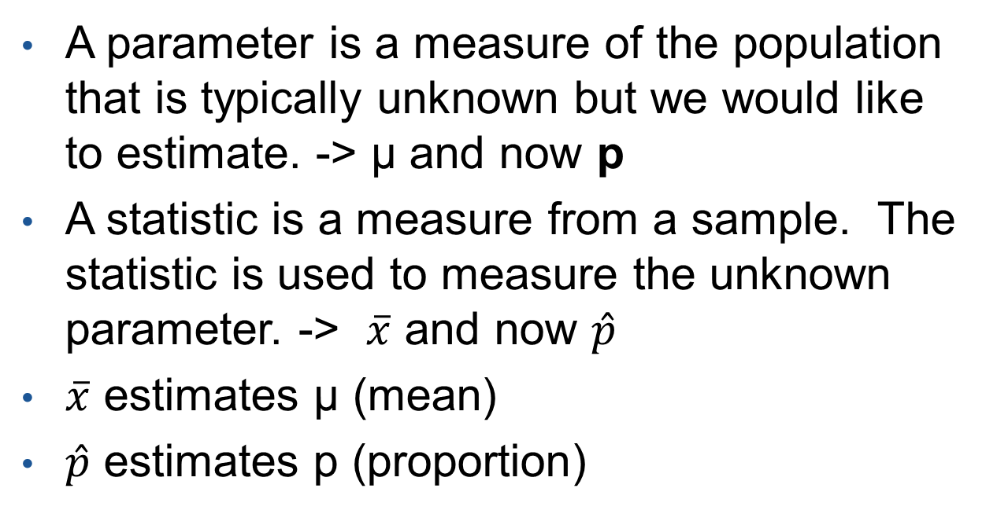
Parameter and Statistic
A parameter is a measure of the population that is typically unknown but we would like to estimate. -> µ and now p
A statistic is a measure from a sample. The statistic is used to measure the unknown parameter. -> $\overline{x}$ and now $\hat{p}$
$\overline{x}$ estimates µ (mean)
$\hat{p}$ estimates p (proportion)

Slide 4
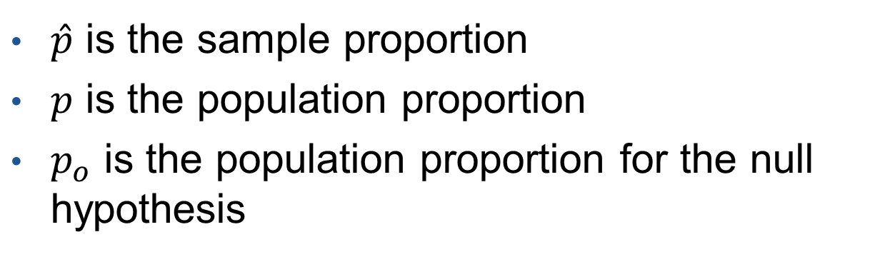
The different p’s
$\hat{p}$ is the sample proportion
$p$ is the population proportion
$p_{o}$ is the population proportion for the null hypothesis

Slide 5
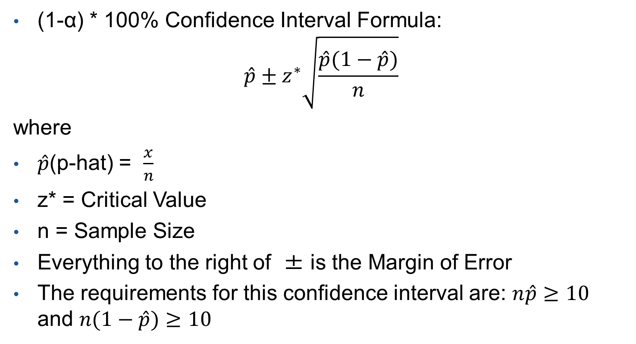
Confidence Interval (Con’t)
(1-α) * 100% Confidence Interval Formula:
$$\hat{p}±z^{∗}\sqrt{\frac{\hat{p}(1−\hat{p})}{n}}$$
where
$\hat{p}$(p-hat) = $\frac{x}{n}$
z* = Critical Value
n = Sample Size
Everything to the right of ± is the Margin of Error
The requirements for this confidence interval are: $n\hat{p}≥10$ and $n(1−\hat{p})≥10$

Slide 6

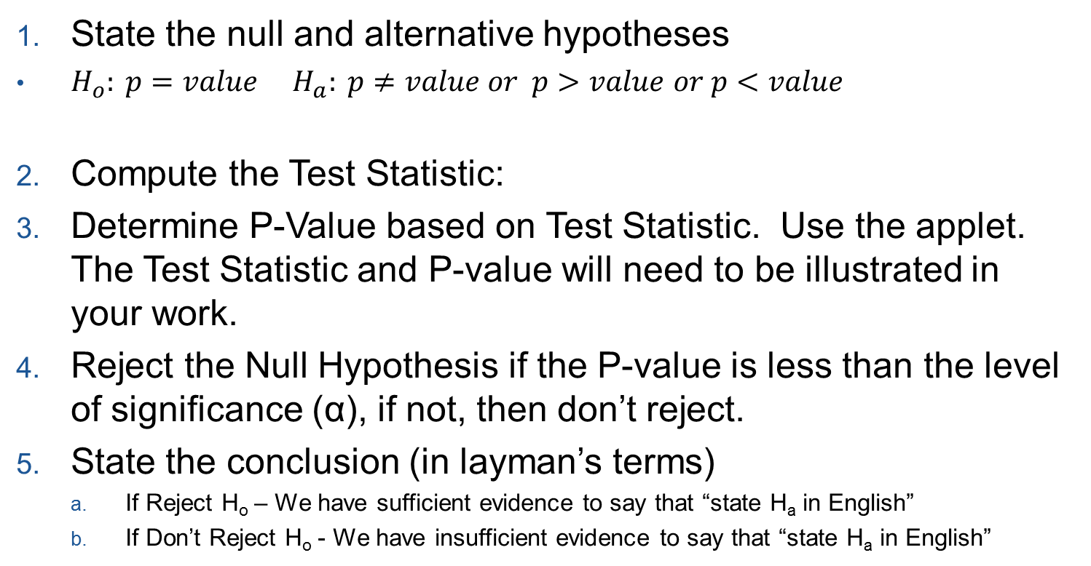
Steps to Hypothesis Testing
State the null and alternative hypotheses
$H_{o}: p=value$ $H_{a}: p≠value or p>value$ $or p<value$
Compute the Test Statistic:
Determine P-Value based on Test Statistic. Use the applet. The Test Statistic and P-value will need to be illustrated in your work.
Reject the Null Hypothesis if the P-value is less than the level of significance (α), if not, then don’t reject.
State the conclusion (in layman’s terms)
If Reject H_{o} – We have sufficient evidence to say that “state H_{a} in English”
If Don’t Reject H_{o} - We have insufficient evidence to say that “state H_{a} in English”

Slide 7
Two Proportion
Review
Confidence Intervals
Hypothesis Testing

Slide 8
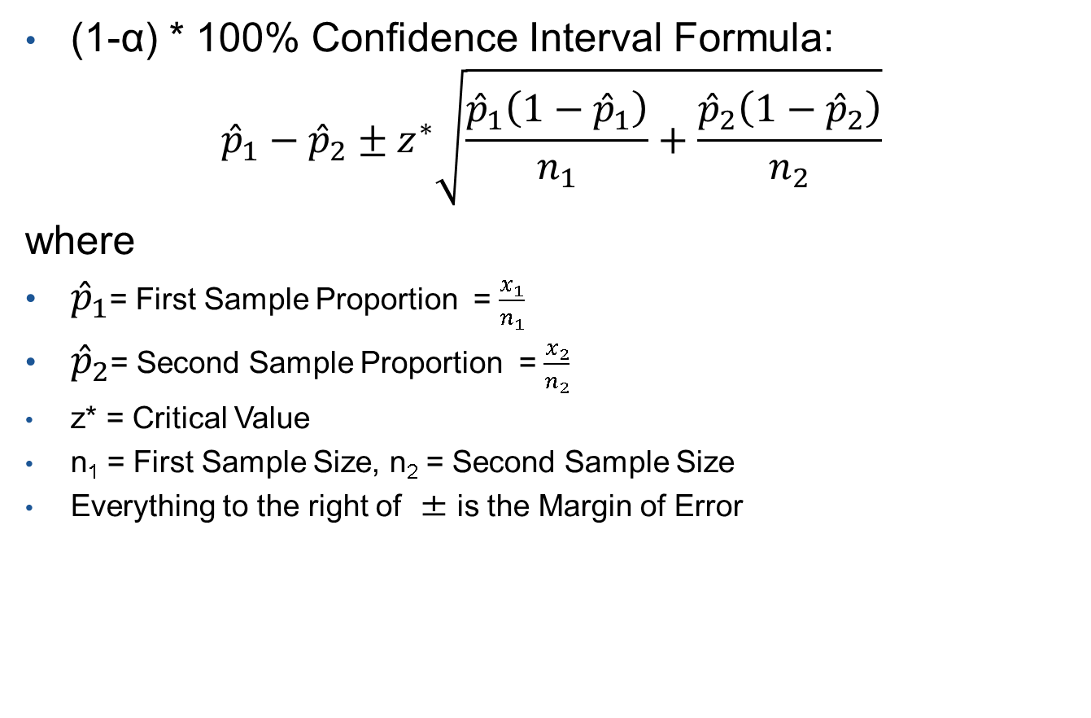
Confidence Interval (Two Proportion)
(1-α) * 100% Confidence Interval Formula:
$${\hat{p}}_{1}−{\hat{p}}_{2}±z^{∗}\sqrt{\frac{{\hat{p}}_{1}\left(1−{\hat{p}}_{1}\right)}{n_{1}}+\frac{{\hat{p}}_{2}\left(1−{\hat{p}}_{2}\right)}{n_{2}}}$$
where
${\hat{p}}_{1}$= First Sample Proportion = $\frac{x_{1}}{n_{1}}$
${\hat{p}}_{2}$= Second Sample Proportion = $\frac{x_{2}}{n_{2}}$
z* = Critical Value
n₁ = First Sample Size, n₂ = Second Sample Size
Everything to the right of ± is the Margin of Error

Slide 9
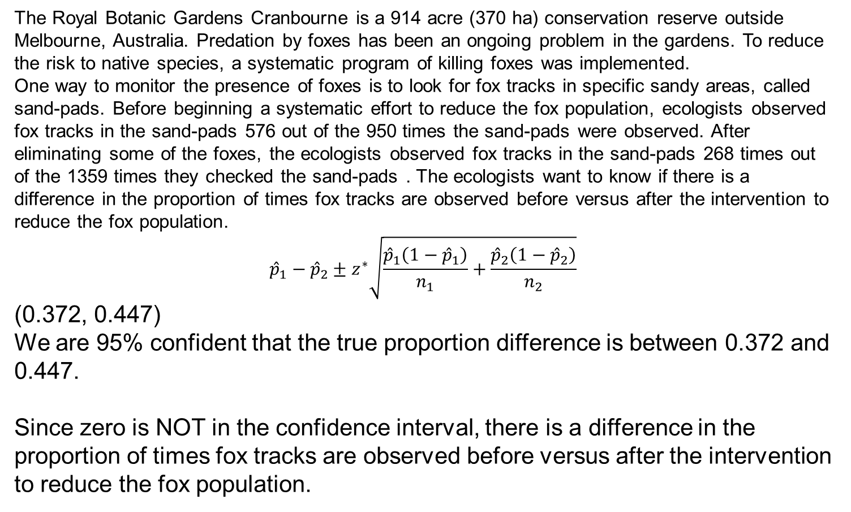
Test of Hypothesis (Example)
The Royal Botanic Gardens Cranbourne is a 914 acre (370 ha) conservation reserve outside Melbourne, Australia. Predation by foxes has been an ongoing problem in the gardens. To reduce the risk to native species, a systematic program of killing foxes was implemented.
One way to monitor the presence of foxes is to look for fox tracks in specific sandy areas, called sand-pads. Before beginning a systematic effort to reduce the fox population, ecologists observed fox tracks in the sand-pads 576 out of the 950 times the sand-pads were observed. After eliminating some of the foxes, the ecologists observed fox tracks in the sand-pads 268 times out of the 1359 times they checked the sand-pads . The ecologists want to know if there is a difference in the proportion of times fox tracks are observed before versus after the intervention to reduce the fox population.
$${\hat{p}}_{1}−{\hat{p}}_{2}±z^{∗}\sqrt{\frac{{\hat{p}}_{1}\left(1−{\hat{p}}_{1}\right)}{n_{1}}+\frac{{\hat{p}}_{2}\left(1−{\hat{p}}_{2}\right)}{n_{2}}}$$
(0.372, 0.447)
We are 95% confident that the true proportion difference is between 0.372 and 0.447.
Since zero is NOT in the confidence interval, there is a difference in the proportion of times fox tracks are observed before versus after the intervention to reduce the fox population.

Slide 10
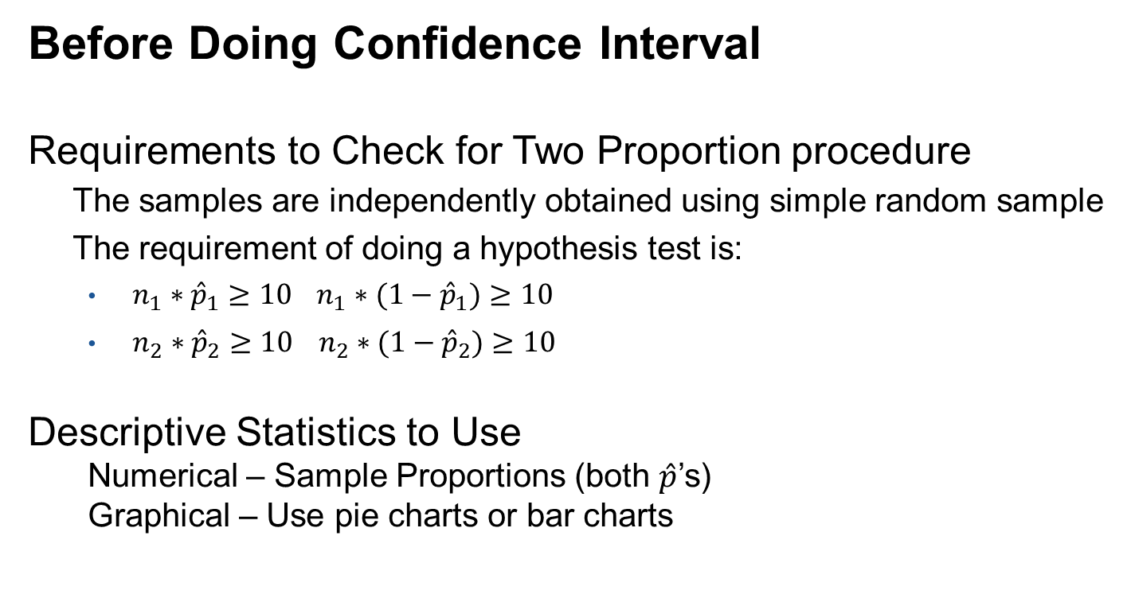
Requirements to Check and Descriptive Statistics
Before Doing Confidence Interval
Requirements to Check for Two Proportion procedure
The samples are independently obtained using simple random sample
The requirement of doing a hypothesis test is:
$n_{1}∗{\hat{p}}_{1}≥10$ $n_{1}∗(1−{\hat{p}}_{1})≥10$
$n_{2}∗{\hat{p}}_{2}≥10 n_{2}∗(1−{\hat{p}}_{2})≥10$
Descriptive Statistics to Use
Numerical – Sample Proportions (both $\hat{p}$’s)
Graphical – Use pie charts or bar charts

Slide 11
Two Proportion
Review
Confidence Intervals
Hypothesis Testing

Slide 12
Types of Hypotheses
Quantitative Data
One Sample (σ Known and Unknown)
H_{o}: μ = value
H_{a}:μ ≠ value, μ < value, or μ > value
Two Independent Samples (σ Unknown)
H_{o}: μ₁ = μ₂
H_{a}:μ₁ ≠ μ₂, μ₁ < μ₂, μ₁ > μ₂
Categorical Data
One Proportion
H_{o}: p = value
H_{a}:p ≠ value, p < value, or p > value
Two Proportions
H_{o}: p₁ = p₂
H_{a}:p₁ ≠ p₂, p₁ < p₂, p₁ > p₂

Slide 13
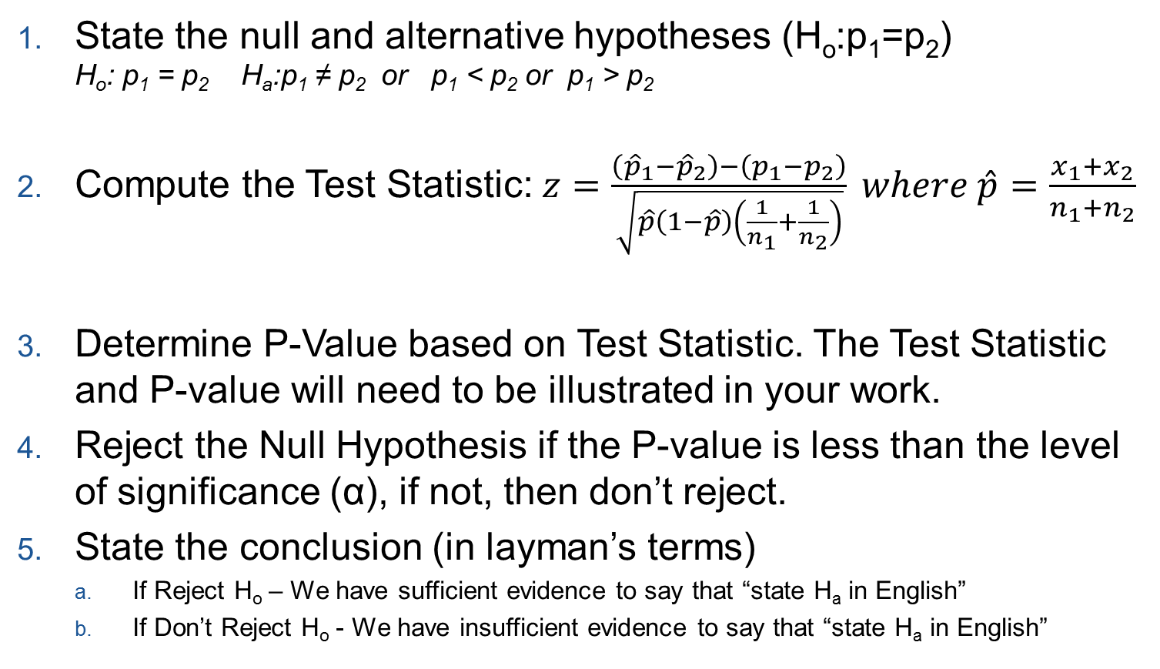
Steps to Hypothesis Testing (Two Proportions)
State the null and alternative hypotheses (H_{o}:p₁=p₂)
H_{o}: p₁ = p₂ H_{a}:p₁ ≠ p₂ or p₁ < p₂ or p₁ > p₂
Compute the Test Statistic: $z=\frac{\left({\hat{p}}_{1}−{\hat{p}}_{2}\right)−\left(p_{1}−p_{2}\right)}{\sqrt{\hat{p}\left(1−\hat{p}\right)\left(\frac{1}{n_{1}}+\frac{1}{n_{2}}\right)}} where \hat{p}=\frac{x_{1}+x_{2}}{n_{1}+n_{2}}$
Determine P-Value based on Test Statistic. The Test Statistic and P-value will need to be illustrated in your work.
Reject the Null Hypothesis if the P-value is less than the level of significance (α), if not, then don’t reject.
State the conclusion (in layman’s terms)
If Reject H_{o} – We have sufficient evidence to say that “state H_{a} in English”
If Don’t Reject H_{o} - We have insufficient evidence to say that “state H_{a} in English”

Slide 14
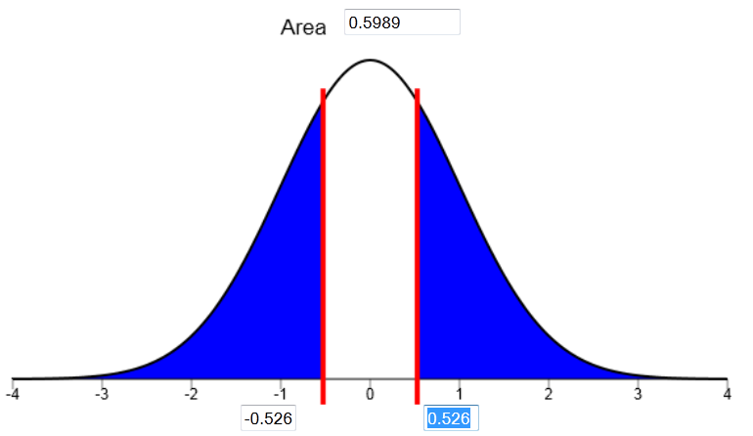
Test of Hypothesis (Example)
Is the proportion of men that taste PTC different than the proportion of women? Based on a recent study done by Elise Johnson, she found that out of 66 females, 51 could taste PTC. Out of 52 males, 38 could taste PTC. Test the claim that the proportion of men and women who taste PTC is different with a level of significance α=0.05.
H_{o}: p₁ = p₂ H_{a}: p₁ ≠ p₂
Z= 0.526
P-value = 0.599
P-value is greater than α, so we don’t reject the null hypothesis.
We have insufficient evidence that the proportion of men and women who can taste PTC is different.

Slide 15
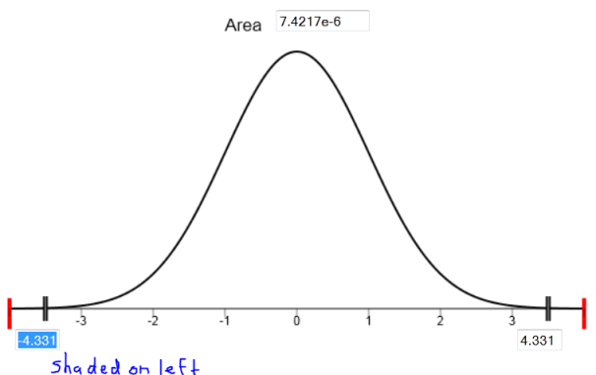
Test of Hypothesis (Example)
Some people have claimed that mortality (death) rates are higher for patients admitted to a hospital on a weekend compared to patients admitted on a weekday. The problem is that the quality of care in an emergency care facility may differ at different times of the week. Doctors Bell and Redelmeier hypothesized that the probability that a patient with an aortic aneurysm will die is greater if they are admitted to a hospital on a weekend compared to a weekday. Out of those 4,145 patients admitted during the weekday, 1,476 died. Out of those 1,309 patients admitted during the weekend, 553 died. Test to see if a lower percentage die during the weekday vs. the weekend with a level of significance of α=0.05.
H_{o}: p₁ = p₂ H_{a}: p₁ < p₂
Z= -4.331
P-value = close to zero
P-value is less than α, so the null hypothesis is rejected.
We have sufficient evidence that a lower percentage die during the weekday vs. the weekend.

Slide 16
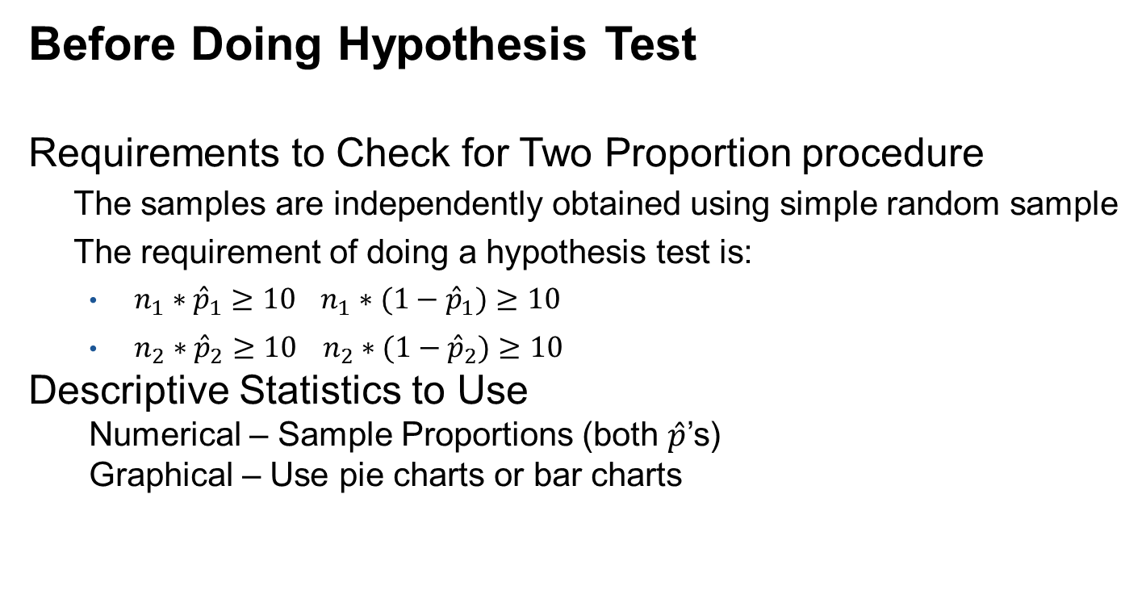
Requirements to Check and Descriptive Statistics
Before Doing Hypothesis Test
Requirements to Check for Two Proportion procedure
The samples are independently obtained using simple random sample
The requirement of doing a hypothesis test is:
$n_{1}∗{\hat{p}}_{1}≥10$ $n_{1}∗(1−{\hat{p}}_{1})≥10$
$n_{2}∗{\hat{p}}_{2}≥10 n_{2}∗(1−{\hat{p}}_{2})≥10$
Descriptive Statistics to Use
Numerical – Sample Proportions (both $\hat{p}$’s)
Graphical – Use pie charts or bar charts

